Slide 1
Vendor
Treatment Reference Guide
U.S. Probation & Pretrial Services
Walter P. Matthews,
Chief U.S. Probation Officer
District of Delaware

Slide 2
Contact Information
Martin P. Durkin, Drug/Alcohol/Mental Treatment Specialist
U.S. Probation & Pretrial Services
824 Market Street, Suite 400
Wilmington, DE 19801
302-252-2967
Martin_Durkin@dep.uscourts.gov

Slide 3
Contact Information for Billing
Jodi L. Kochaba, Clerical Supervisor
U.S. Probation & Pretrial Services
824 Market Street, Suite 400
Wilmington, DE 19801
302-252-2953
Jodi_Kochaba@dep.uscourts.gov

Slide 4
Overview
Monitoring Reports
Billing Procedures
Treatment Forms
Chain of Custody and UA Testing

Slide 5
Post Award Monitoring
Provider awarded a blanket purchase agreement is subject to mandatory post-award monitoring visits.
Post-award monitoring visits conducted within 120 days of initial award and when exercising an option to renew a BPA.

Slide 6
Monitoring Reports
Further monitoring visits will occur when exercising the option to renew BPA for Year 2 and Year 3; and, if deficiencies or problems occur or an “unsatisfactory” or “unacceptable” rating is issued to a vendor.

Slide 7
Billing Procedures
Invoice Example - Part A and Part B
Mandatory - Invoices to be submitted on or before the 10th of each month.
Billing should properly reflect charges in units. Units are in 30 minute increments.

Slide 8
Billing Procedures (cont.)
Invoices must be submitted through the Electronic Reporting System. http://ers.uscourts.gov/
Important - Pacts Number and correct client name on all documents submitted.
Further invoice guidance can be found at: http://www.dep.uscourts.gov

Slide 9
Page 1
Billing

Slide 10
Page 2
Billing

Slide 11
Treatment Plan/Prob. 45
Vendors should have a completed, signed Prob. 45/treatment plan in their possession before rendering services.
Services reflected on Prob. 45 are the only authorized services to be provided to a client.

Slide 12
Treatment Plan/Prob. 45
If vendor believes client needs services beyond those authorized, the vendor must contact the Probation Office and obtain an amended Prob. 45 authorizing the additional services.

Slide 13
Sample

Slide 14
Monthly Treatment Report / Prob. 46
Record of a client’s compliance with the treatment plan.
Assists the assigned officer in monitoring clients overall compliance.
Vendors must notify the USPO within 24 hours in writing, i.e. fax, or e-mail if offender fails to report for treatment.

Slide 15
MTR/Prob. 46 (cont.)
Probation Form 46 is available in electronic form and will be provided to vendor.
All Monthly Treatment Reports must be typed – no exceptions.
Important: Documents submitted will be scanned into Adobe and submitted electronically.

Slide 16
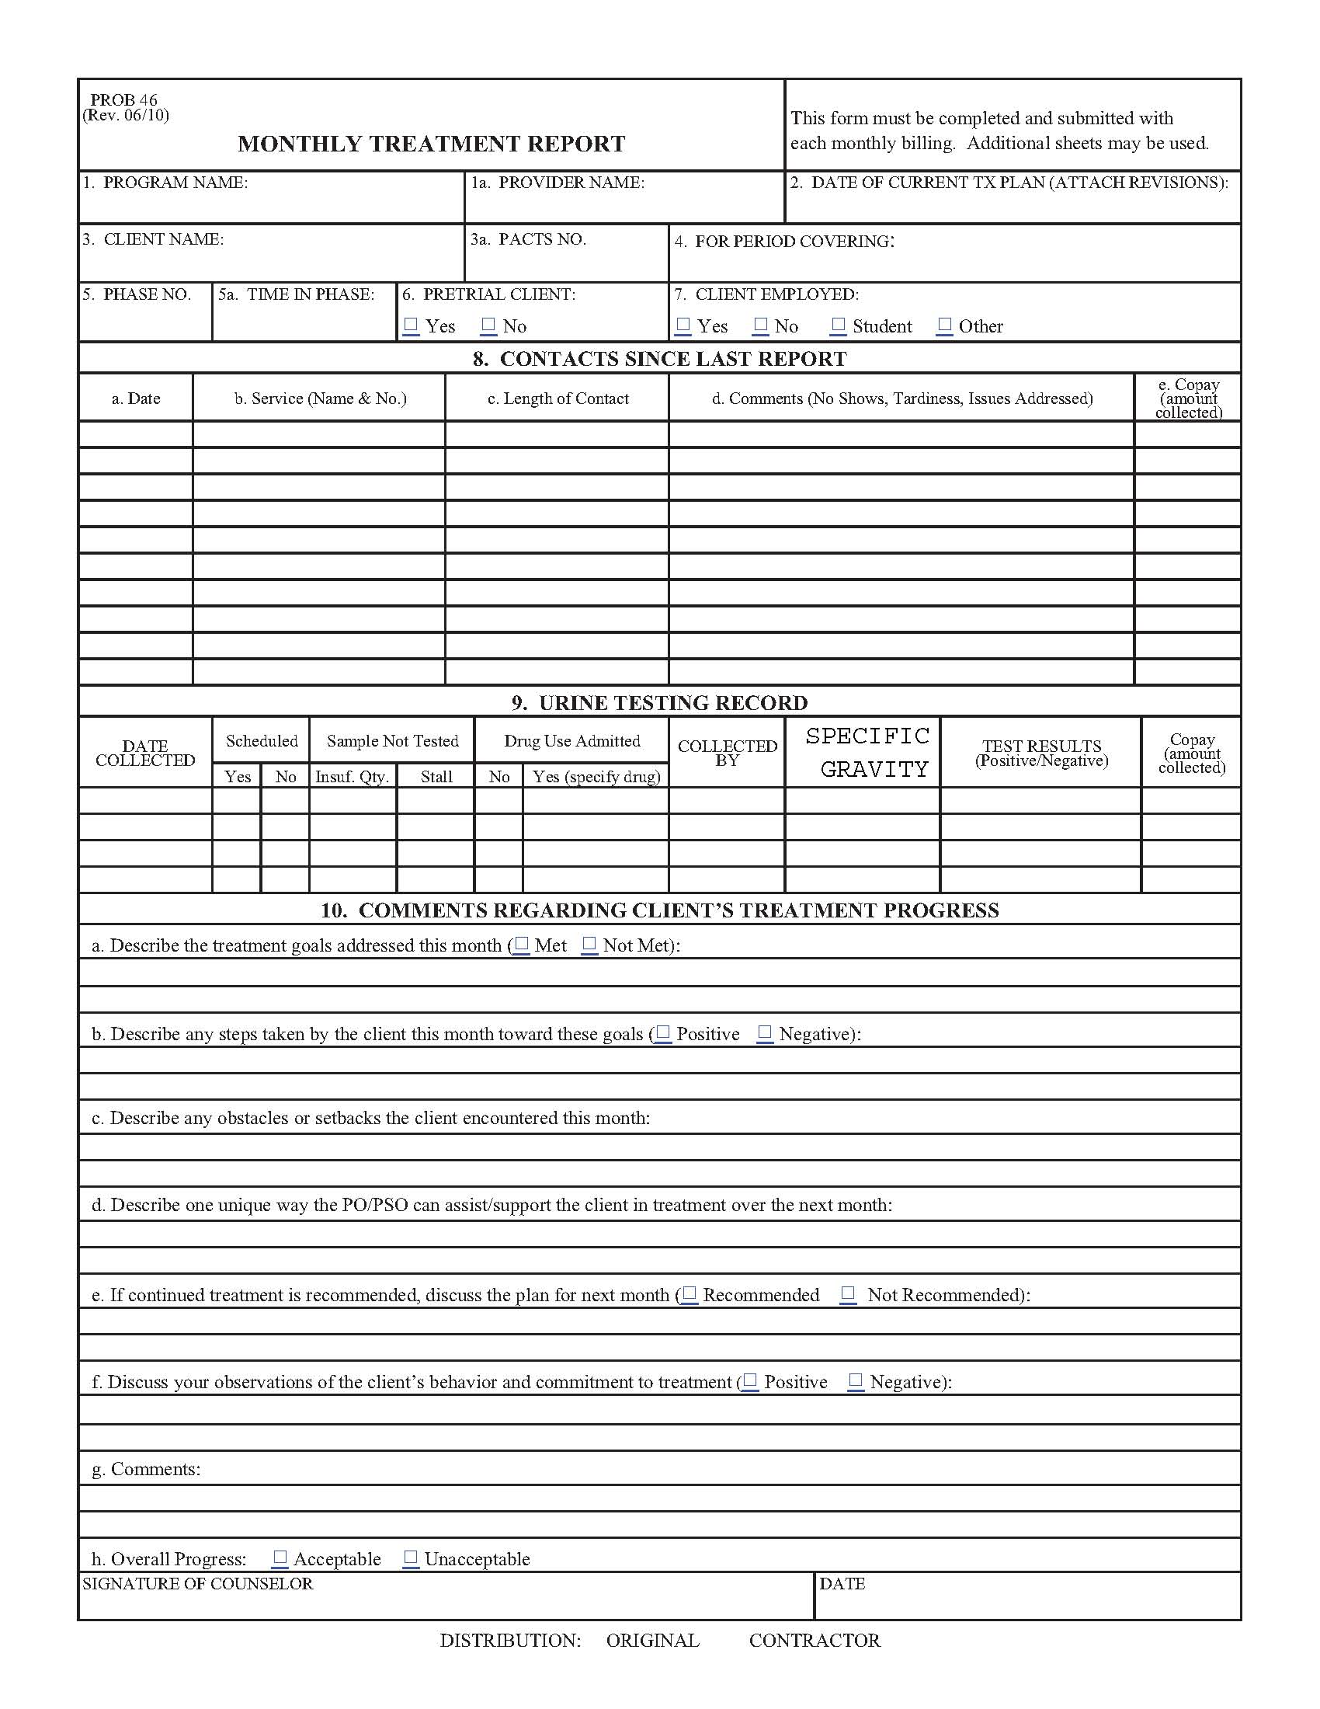
MTR Prob. 46 Sample

Slide 17
Authorized Releases/Probation Form 11B, 11I, 6B and 6D
Ensure form is filled out completely and signed by the Probation Office.
Vendors must maintain signed release forms in each clients treatment file.

Slide 18
Release Sample

Slide 19
Vendor Treatment Plans
Provider should develop a treatment plan which includes: (a) short and long term goals for the defendant(s)/offender(s);
(b) measurable objectives;
(c) type and frequency of services to be received;

Slide 20
Vendor Treatment Plans (cont.)
(d) specific criteria for treatment completion and the anticipated time-frame;
(e) documentation of treatment plan review, at least every 90 days, to include the following:

Slide 21
Vendor Treatment Plan (cont.)
Defendant’s/offender’s input, continued need for treatment, and information on family and significant others involvement (i.e., community support programs, etc.).
Treatment Plan needs to be attached to the monthly treatment report every 90 days.

Slide 22
Treatment Plan Sample

Slide 23
Daily Treatment Log
Offender/defendant signs in and out for each service
Each service must be listed on a separate line (i.e. counseling and testing)
Vendor also signs each entry
Logs must be submitted with monthly invoices.

Slide 24
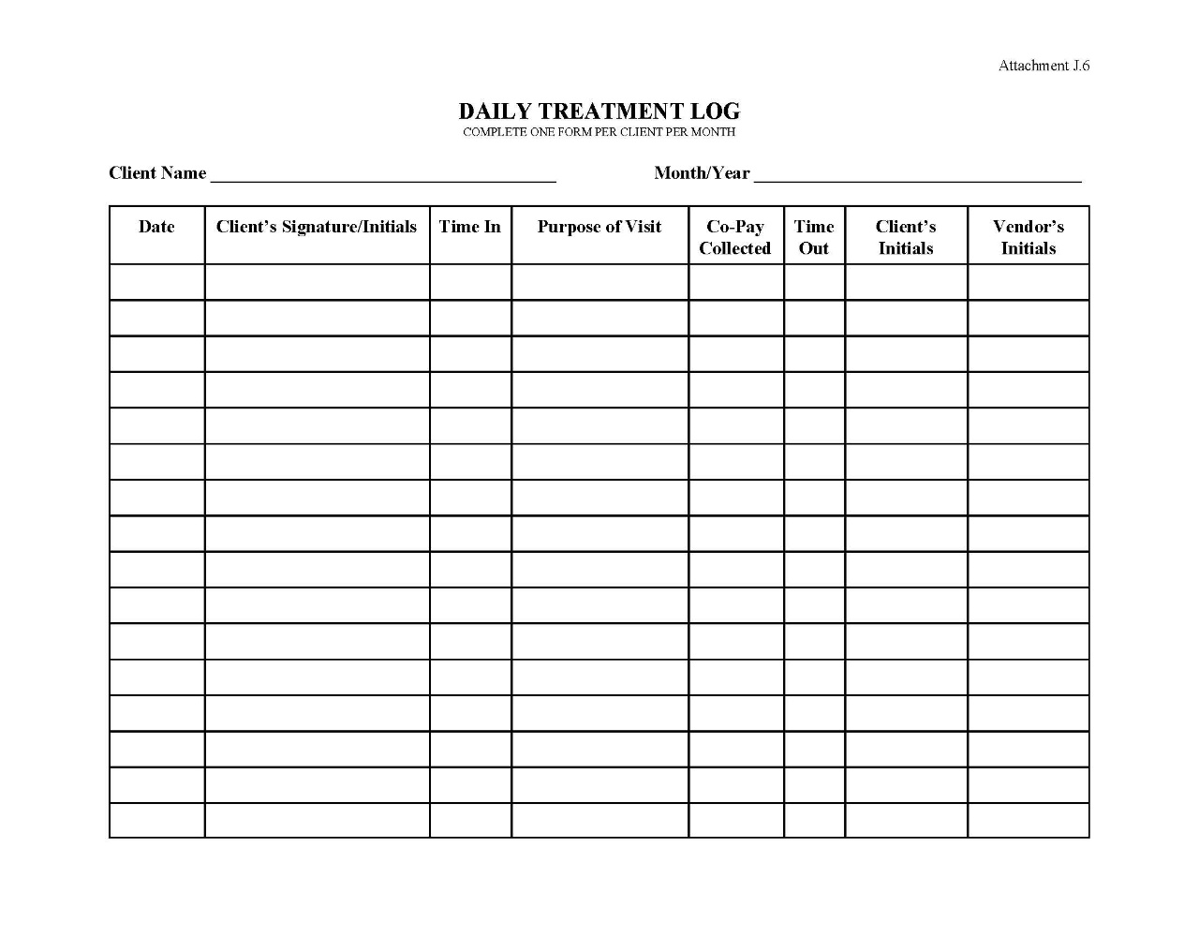
Sample

Slide 25
Urine Collection
All supplies will be provided by our office (urine bottles, Chain of Custody forms, mailing labels, mailing boxes, etc.)
Urine collected will be mailed to our national lab.
Only positive results will be provided to your agency.

Slide 26
Urine Collection
Must be legible/Print
Must keep letters/numbers within the boxes provided
Must include officer initials
Must include PACTS number
Compliance with collection methods are outlined in the Statement of Work, page C-4 thru C-19.

Slide 27
Sample

Slide 28
Required File Documents
Program Plan
Authorization to Rel. Confidential Information 11B
Monthly Treatment Reports
Chain of Custody forms
Laboratory results
Daily Treatment Log

Slide 29
File Documents (cont.)
Individual UA logs
Chronological notes that include Officer contact and counseling notes

Slide 30
Termination of Services
Program Plan does not require offender/defendant signature
Maintained in your file
If counseling provided, must complete a typed discharge summary to USPO within 15 calendar days

Slide 31

Questions???
For more in depth information, please refer back to your Statement of Work.
http://www.dep.uscourts.gov

