Slide 1
Daily Treatment Log
Offender/defendant signs in and out for each service
Each service must be listed on a separate line (i.e. counseling and testing)
Vendor also signs each entry
Must be submitted with monthly invoices.

Slide 2
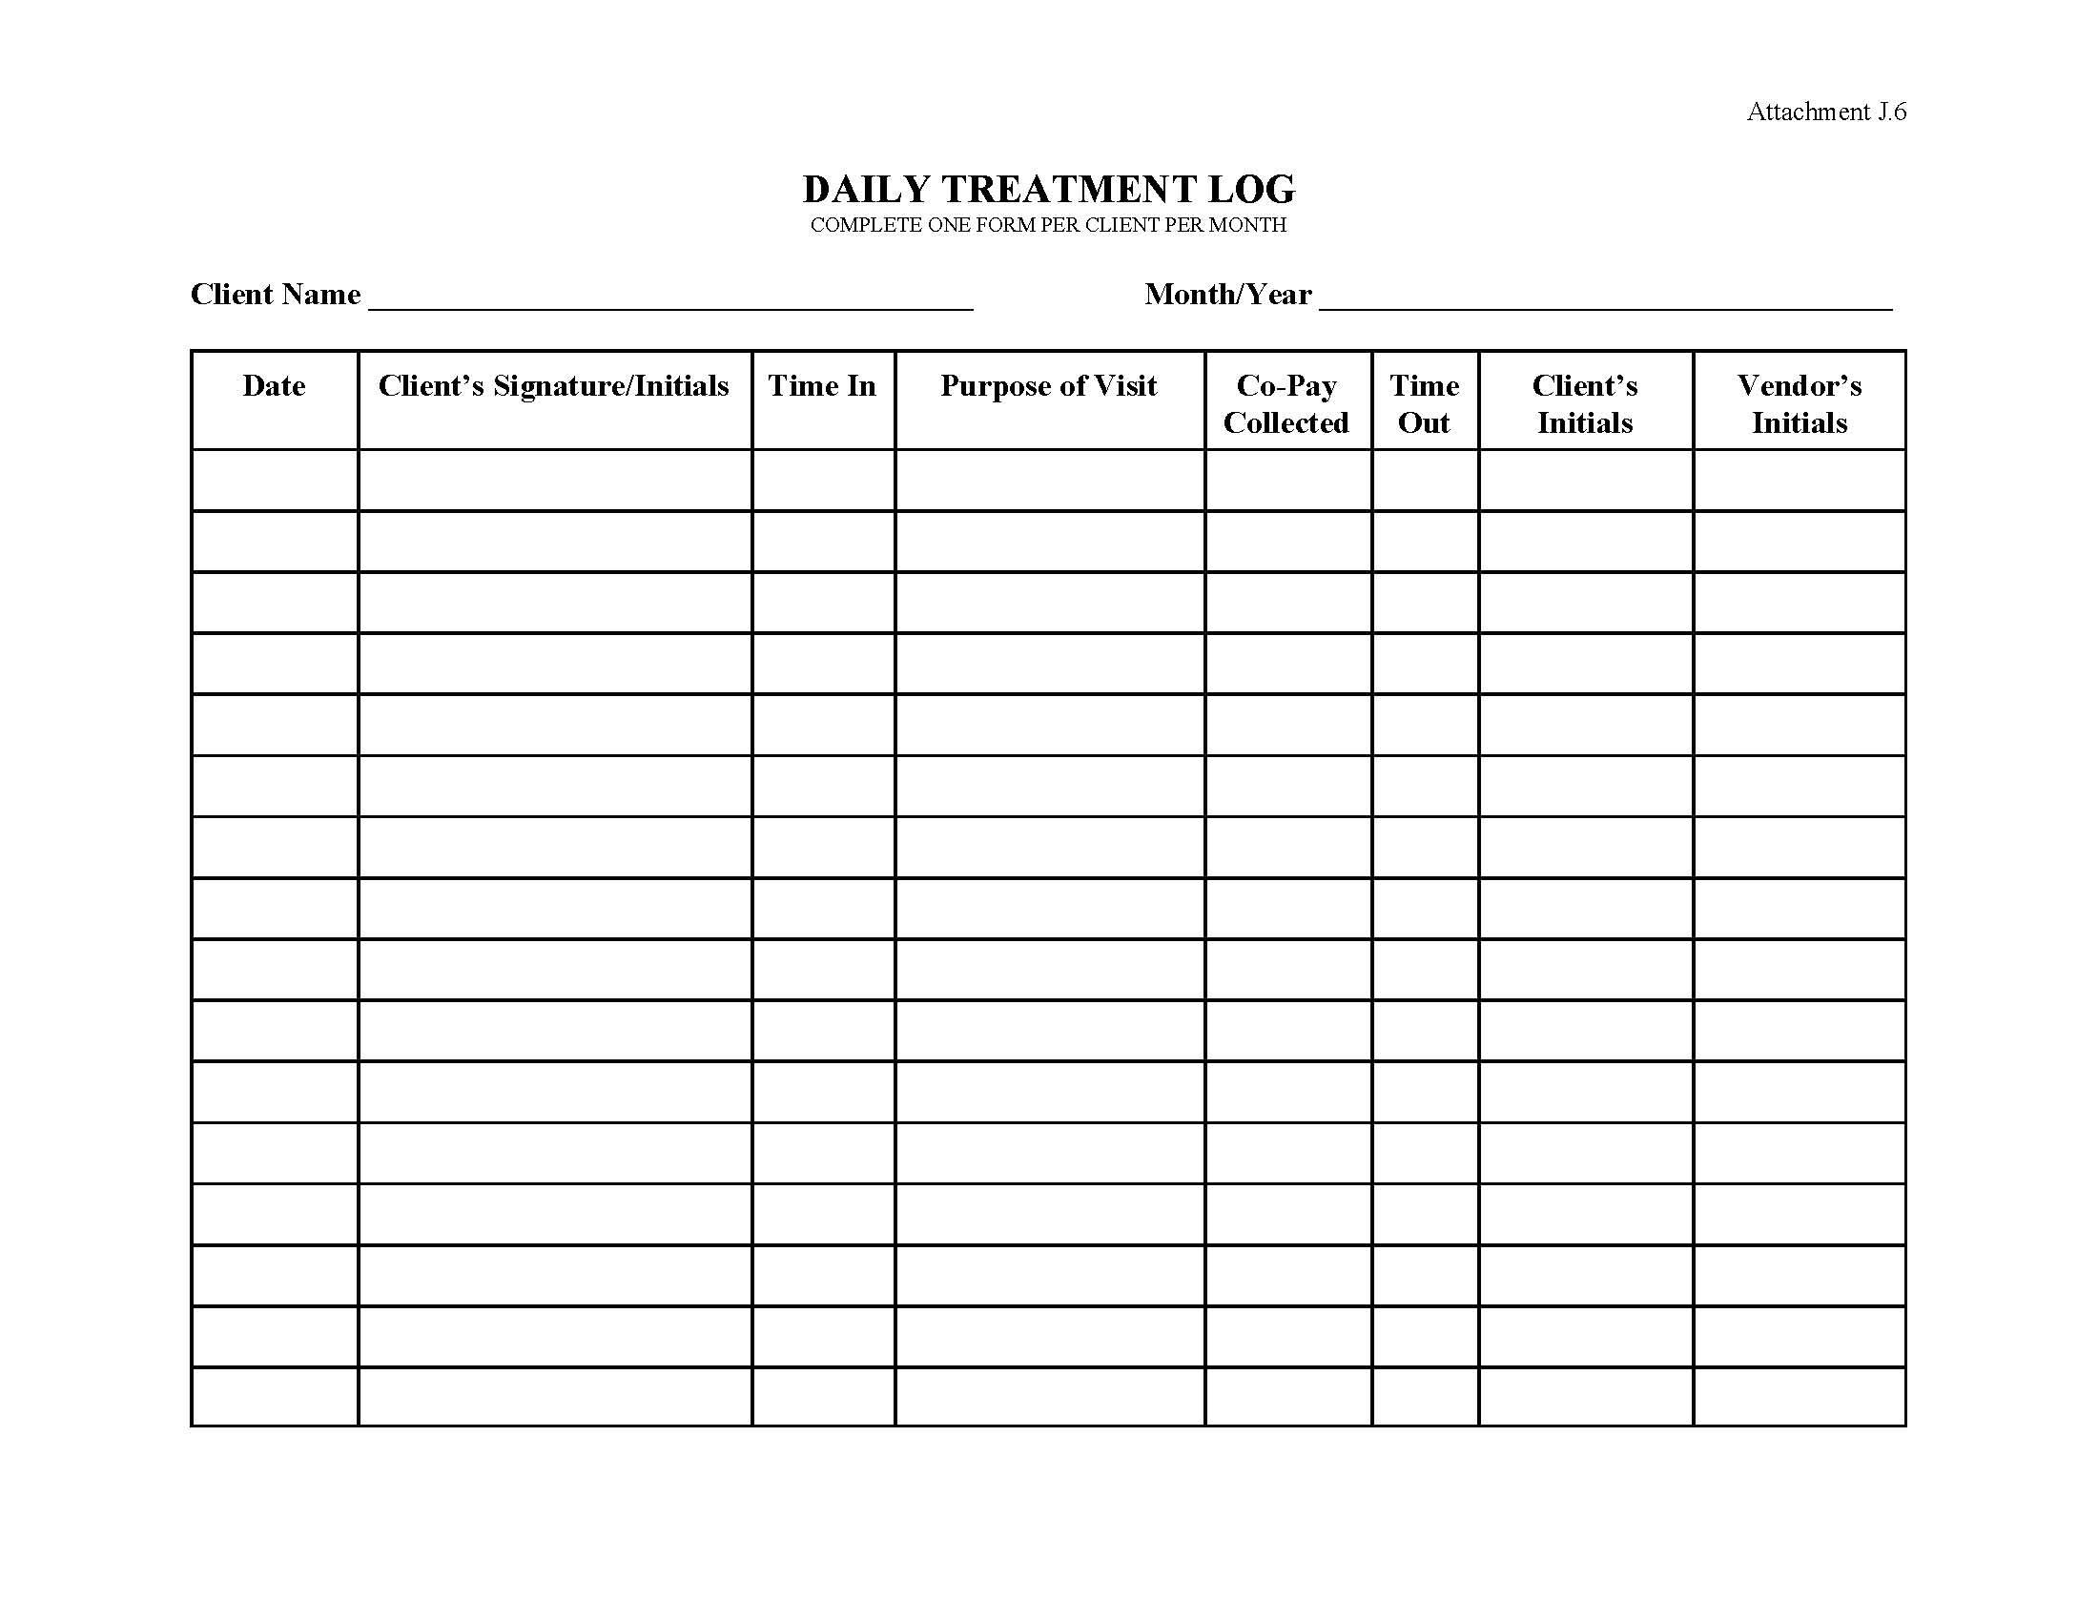
Sample

